Slide 1
Get Start with AngularJS
Howard, VMware

Slide 2

Agenda
Brief Introduction
Basic Concepts
Quick start
Practice

Slide 3
What you need to know
HTML & CSS
Javascript

Slide 4

AngularJS intro

Slide 5

HTML enhanced for web apps!

Slide 6
Why Use Angular
Angular helps you to organize your Javascript
Angular is a MVC framework
Angular separates view template with Javascript logic code
Angular helps you to create responsive websites fast
Angular is Easy to test

Slide 7
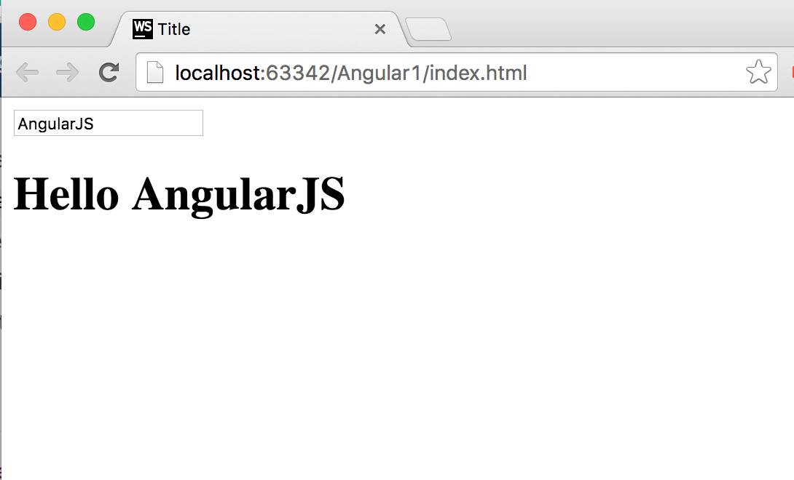
Short demo：

Slide 8
A journey of a thousand miles begins with a single step
-Lao Zi

Slide 9
Basic Concepts

Slide 10
Data BiNding
Model
View
$scope.content
Two
{{ content }}
ng-model=“content”
Data-binding is an automatic way of updating the view whenever the model changes, as well as updating the model whenever the view changes.

Slide 11
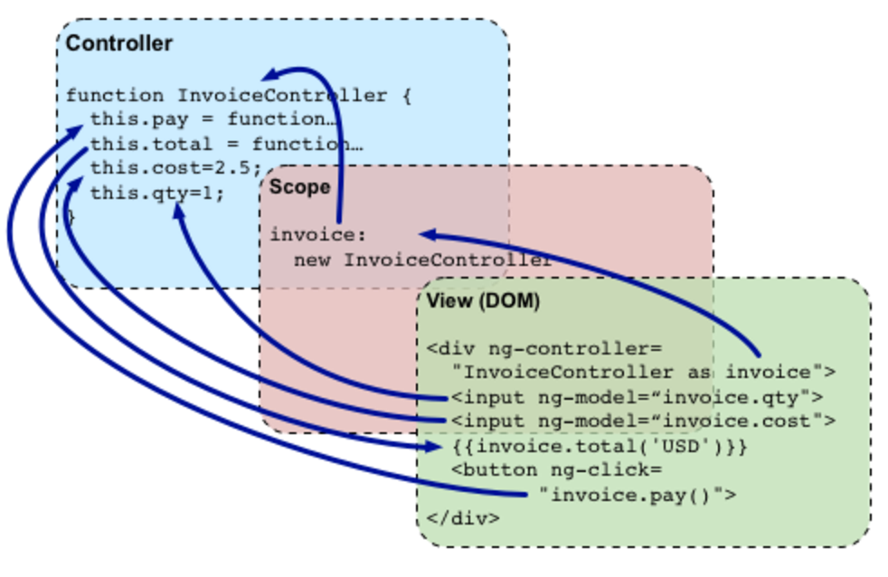
Controller
Controllers are the behaviour behind the DOM elements.
In main controller
app.controller(“main”, ['$scope', function($scope){
$scope.sayHello = function() {
alert(“Hello!”);
};
}]);
In DOM element:
<div ng-controller=“main”>
<button ng-click=“sayHello()”></button>
</div>

Slide 12
Directives
Directives is a unique and powerful feature available only in Angular. Directives let you invent new HTML syntax, specific to your application.
Directive type:
Built-in Directive (prefixed with “ng-”)
Customised Directive

Slide 13

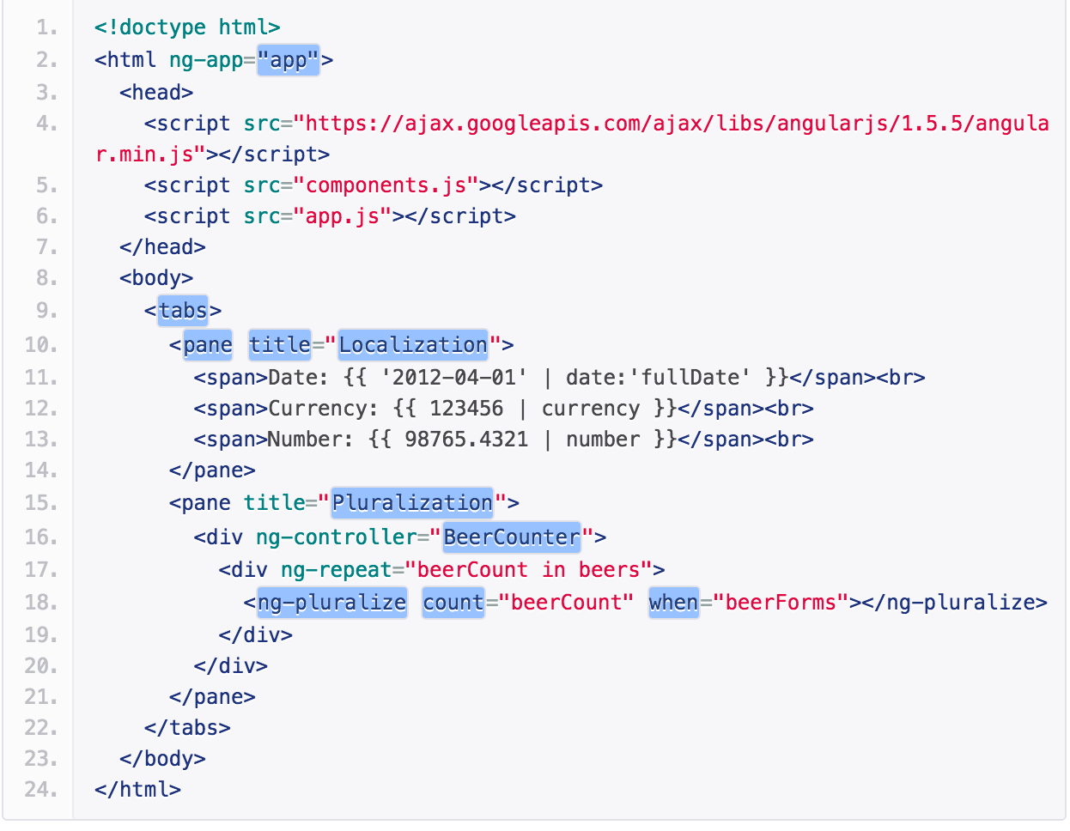
Directives

Slide 14
Directives
An Angular directive comes in four flavours in terms of appearance：
A new HTML element (<date-picker></date>).
An attribute on an element (<input type="text" date-picker/>).
As a class (<input type="text" class="date-picker"/>).
As comment (<!--directive:date-picker-->).

Slide 15

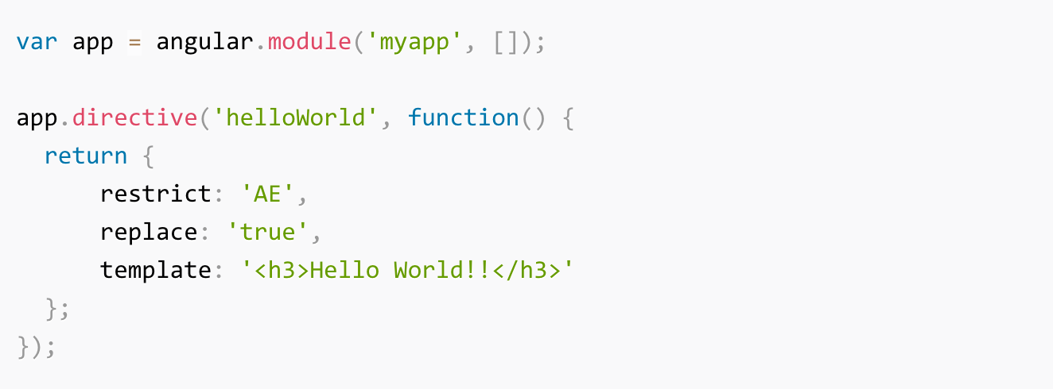
Directives
<hello-world/>
<h3>Hello World!!</h3>

Slide 16
Let’s Get Started!

Slide 17
Required tools
Nodejs
bower
Grunt/Gulp
Webstorm IDE (Or any IDE you like)

Slide 18
Steps to setup dev environment
Use IDE or angular-seed to generate a project skeleton
npm install
bower install
Your dev environment is ready!

Slide 19
Practise

Slide 20
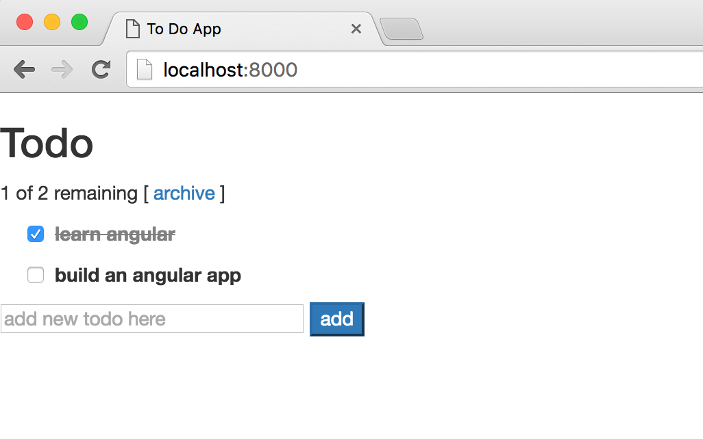
To Do list APP

Slide 21
Online Editor
http://plnkr.co/edit

Slide 22
Thanks

